Slide 1

Career Presentation

Slide 2
Instructions
(delete this slide before presentation)
Please start by downloading this file to your computer and "Save As" to your preferred location so you don't write over the template!
Add or delete slides to fit your presentation needs.
The more photos and graphics, the better. Feel free to add slides to include these and better tell your story visually. If desired, add your own photos and graphics to replace the placeholder photos already on the slides.
Replace the bracketed, italicized text on each slide with your own words. For example, on slide 4 replace [Job/Career Title] with something like “Engine Captain” or “Fire Prevention Technician.”
Try to limit the number of words on each slide.
Use the notes section and relevant prompts on each slide to help guide you with suggested talking points and slide design.
Notes:
Each slide has a notes section to help guide you with suggested slide design, talking points, and prompts.

Slide 3
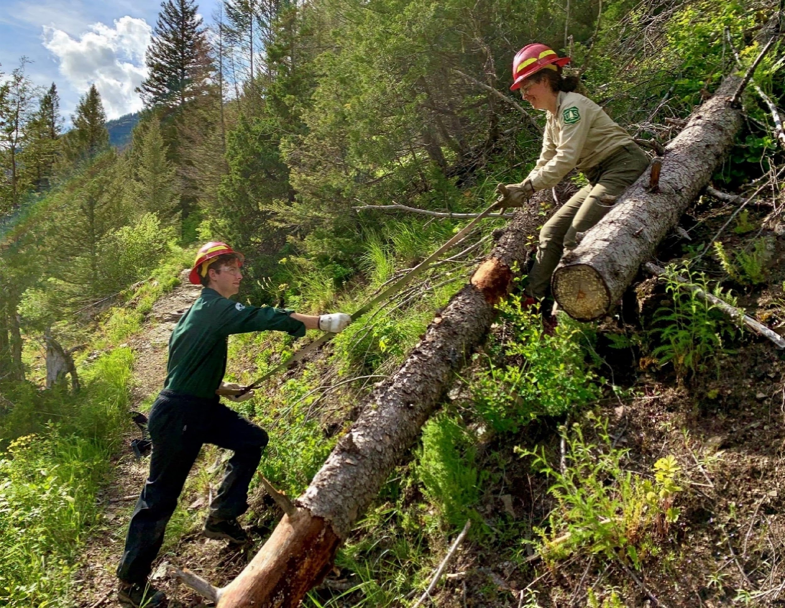
[Career Presentation Title]
USDA Forest Service photo by M. Gosnell.
Notes:
Design
Add a title to your presentation. It could simply be your job title or a catchy title to draw in your audience.
Consider replacing the placeholder image with your own.
Pre-work
Decide what your expectations are for the presentation: when to raise hands, ask questions, and amount of participation from the audience.
Use your work tools, career trunk items, or Fire Ecology Learning Lab props as visual aids and discuss them throughout the presentation.
Consider bringing in more of your own props or visual aids.
Consider doing a hands-on activity with the audience. Make sure to bring enough copies and coordinate with the teacher/organizer.
Placeholder Photo Credit
Forest Service members clear trail debris, Flathead National Forest, Montana. Courtesy photo by Maryssa Gosnell.

Slide 4
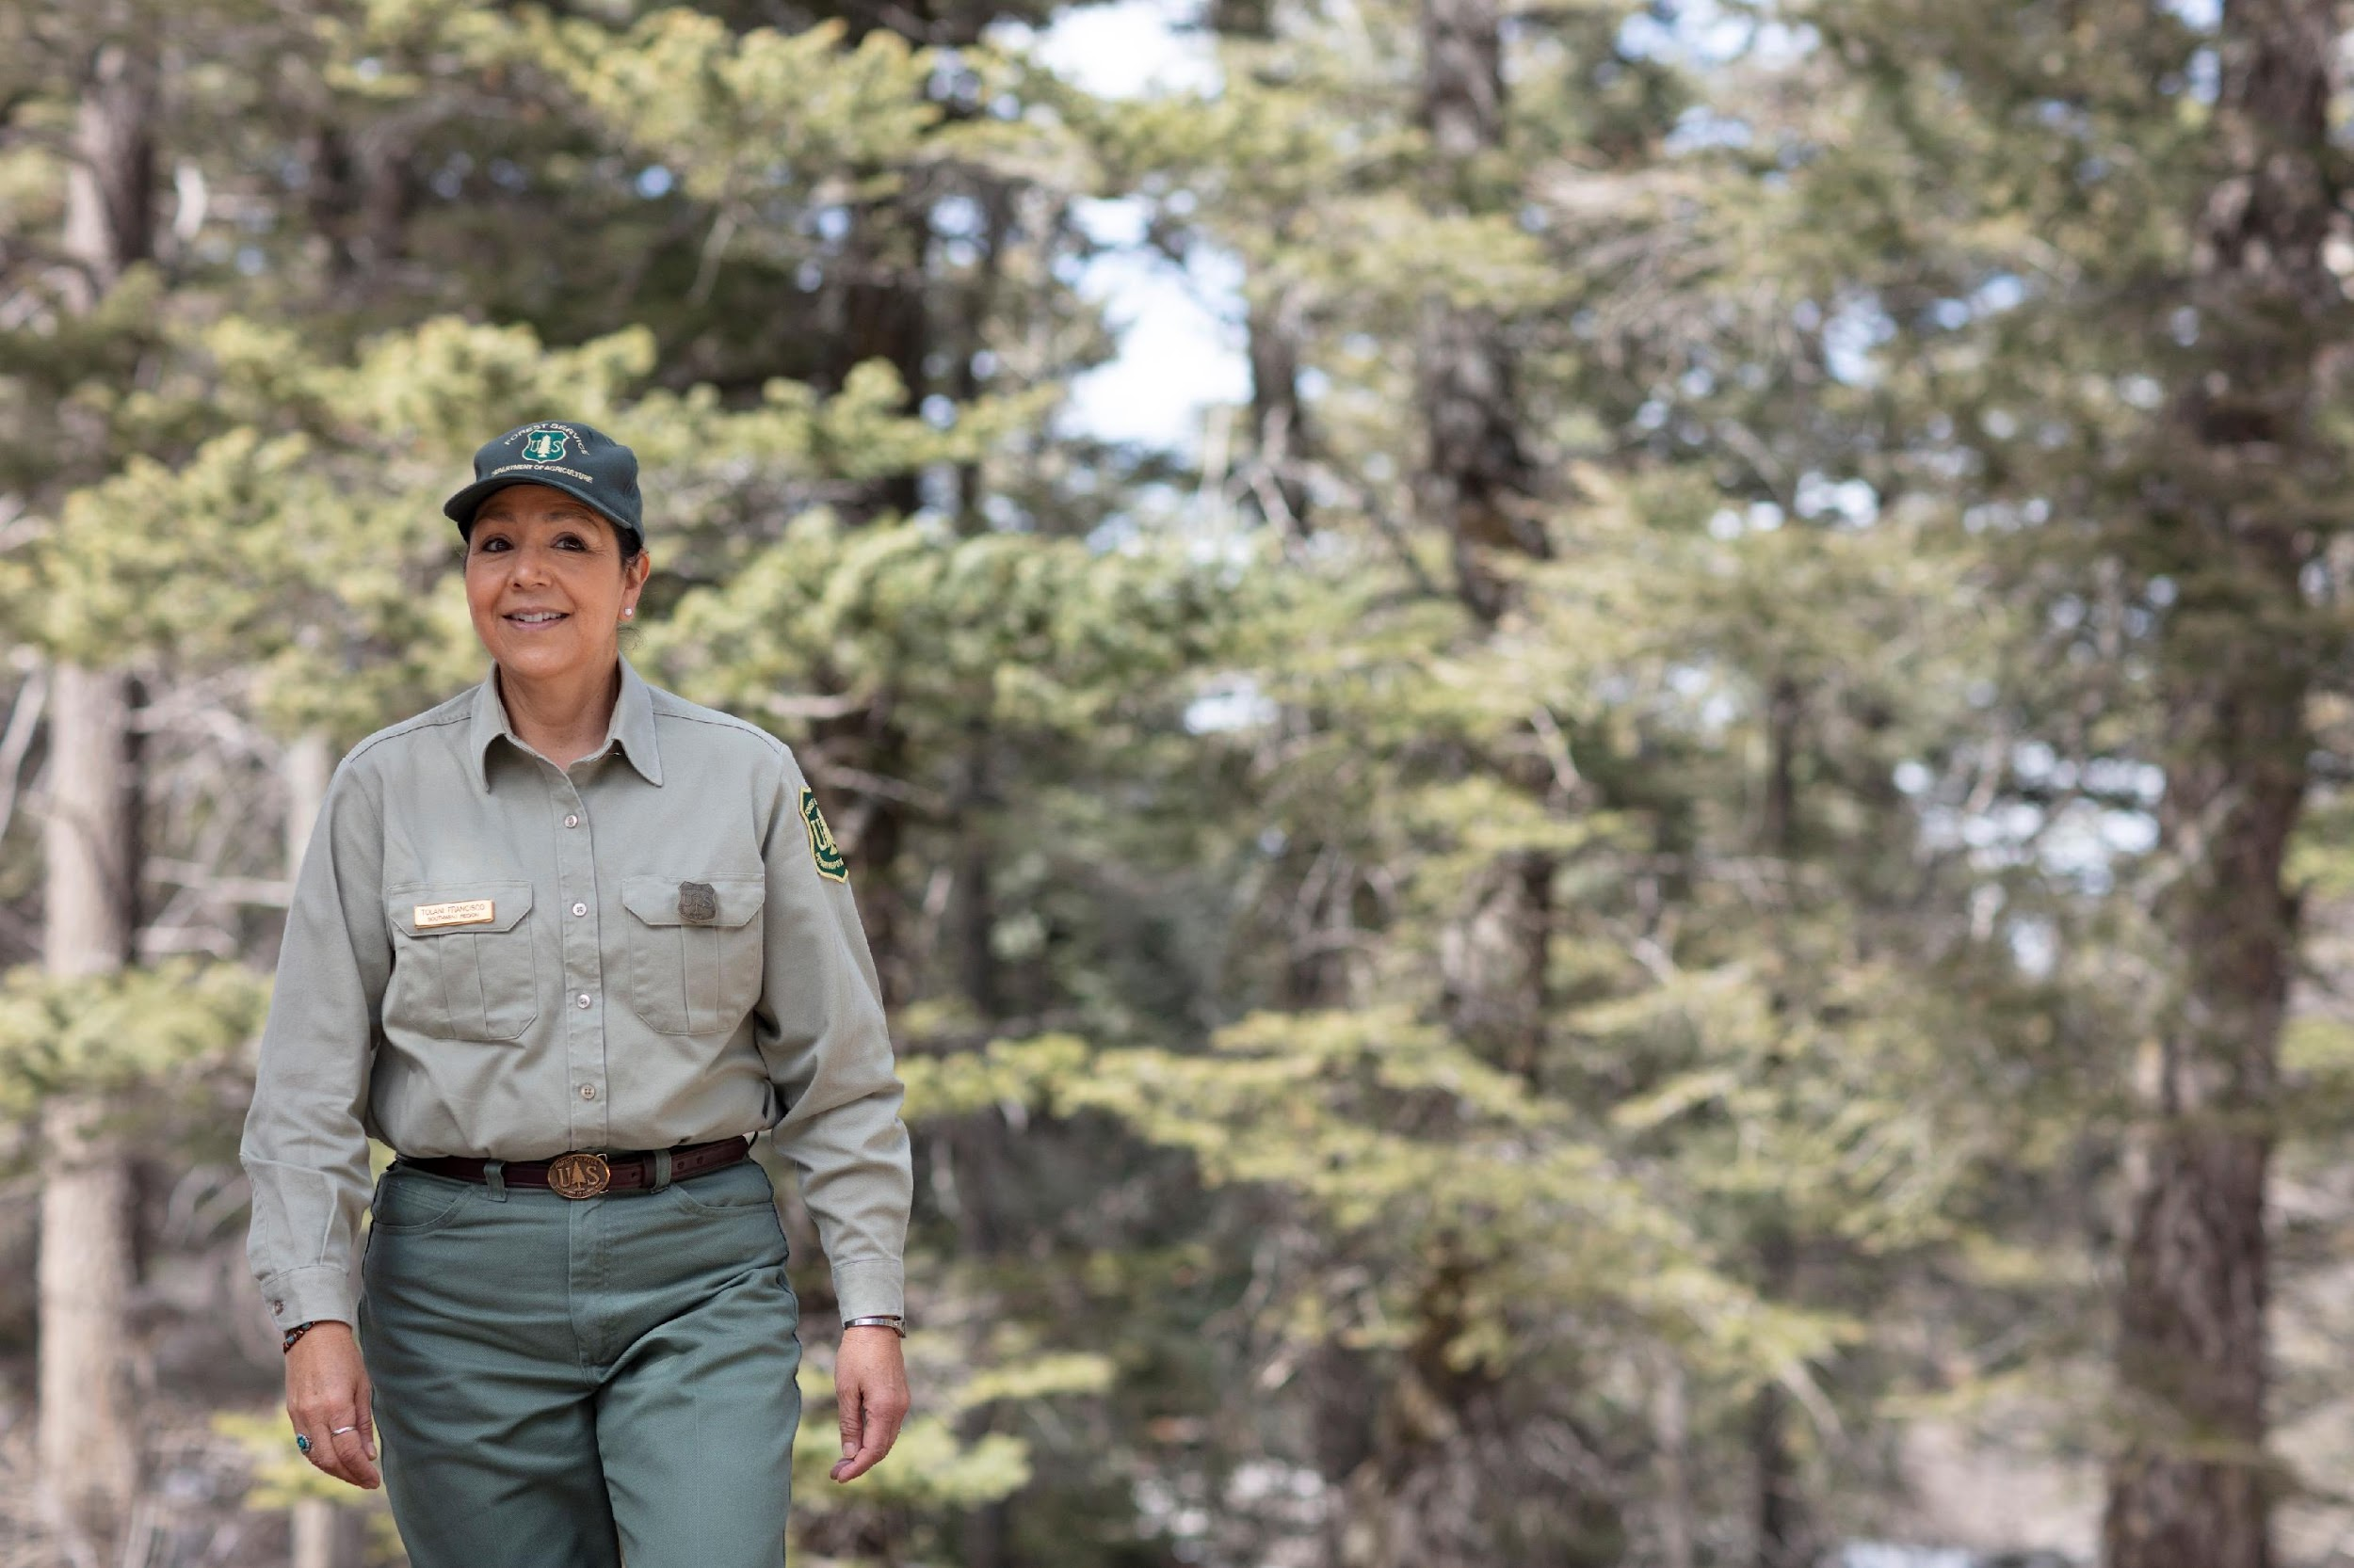

[Job/Career Title]
[Your name]
[Job title]
[Information about your uniform]
USDA Forest Service photo
by A. McMillan.
USDA Forest Service photo
by L. Cheung.
Notes:
Design
Add your introduction heading (your job title or career) and write a brief introduction of yourself. Replace the brackets on the slide with your own information.
Change slide images, if desired.
Presentation Prompts
Introduction slide: introduce yourself, where are you from, and your job title.
A brief note about uniforms: Wearing a uniform has many benefits. If wearing a uniform around a school, you may get mistaken as a police officer; consider talking about and briefly explaining why you wear the uniform and what it means to you. What is unique or special about your uniform? If applicable, consider explaining/sharing information about your agency logo, describing the symbols (e.g., pine tree for the Forest Service, arrowhead and bison for the National Park Service) and what they represent.
Give simple definitions and examples of your career. Describe your job in a way that students can relate to.
Explain how your work relates to classes they might be taking in school, such as math, biology, chemistry, history, etc.
Placeholder Photo Credit
R3 - Regional Wild Horse & Burro Coordinator, Dr. Tolani Francisco, is seen at Capulin Picnic Area in Albuquerque, NM on 03/26/2019. (Forest Service photo by Andy McMillan, Team Pathways2Solutions)
R3_Apache-Sitgreaves National Forest_USDA Photo by Lance Cheung.

Slide 5
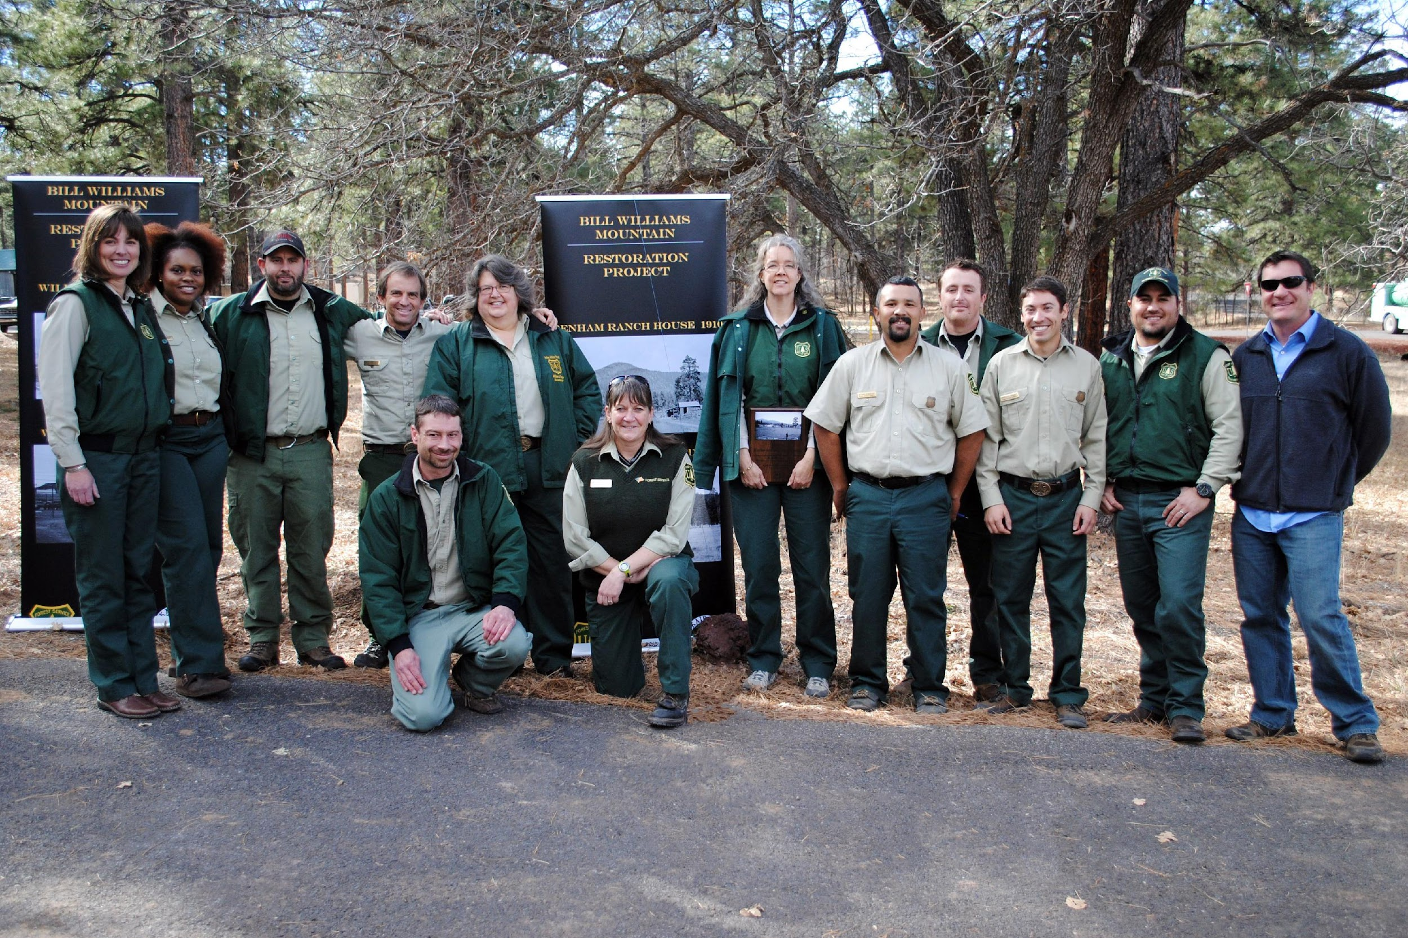
Agency/Organization Name
[How does your career field support your agency/organization’s mission]
[How does your job serve people/community]
USDA Forest Service photo by L. Reed.
Notes:
Design
Add a brief description of how your career field fits with your agency or organization’s mission. Add an image on the slide.
Presentation Prompts
How does your career field support your agency or organization’s mission?
How does your career serve people and community?
Placeholder Photo Credit
Members of the Kaibab National Forest, Williams Ranger District, 12-10-15. 151210-001. Photo by Leslie Reed.

Slide 6
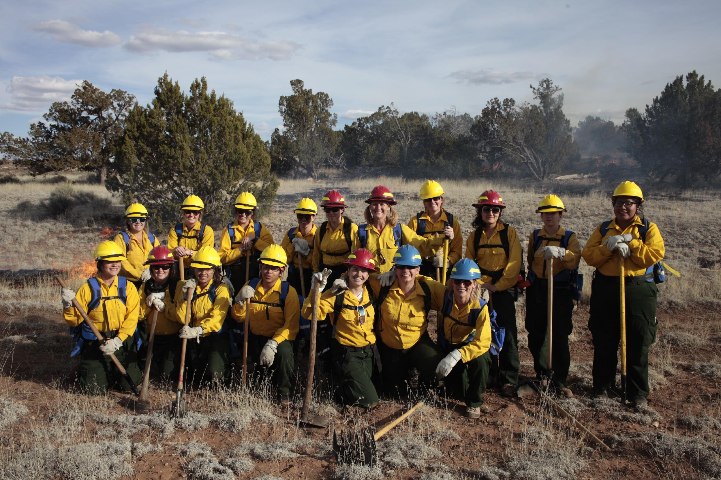
Career Path
[Education]
[Internships]
[First jobs]
USDA Forest Service photo.
Notes:
Design
Share about your career path (schools, internships, first jobs). Add an image or change the slide image, if desired.
Presentation Prompts
With elementary students: focus on a brief summary of your education.
With middle or high school students: talk more in-depth about your education and include a brief summary of trainings, internships, and first jobs.
Did you have a high school job that is connected to fire, the outdoors, or conservation? - Share this with the students to help them see that they can get started now!
Placeholder Photo Credit
Women in Wildland Fire Bootcamp at Coconino National Forest, 2015.

Slide 7
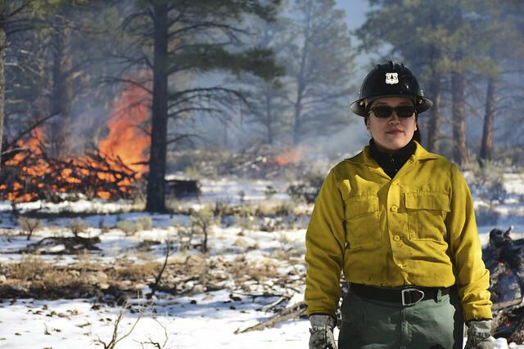
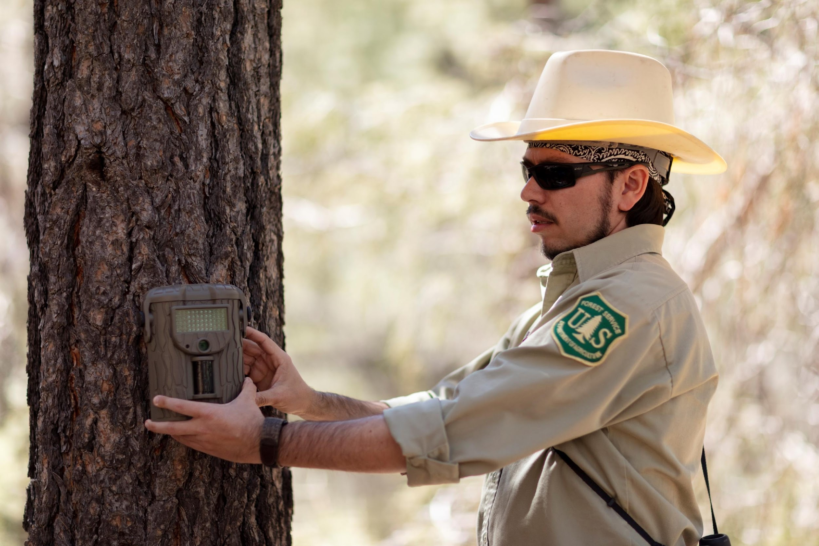
A Day in the Life…
[Example of what you do in your career]
[Tools you use]
[Props/items to share]
USDA Forest Service photo by D. Bone.
USDA Forest Service photo
by A. McMillan.
Notes:
Design
Add a brief description or example of what you do in your career. Change slide image, if desired. Consider changing slide title to fit your presentation.
You could add another example on the next slide.
Presentation Prompts
Share an example or describe what you do in your career. Consider telling a story - use your five senses, talk about who was there with you, was there a life lesson you learned?
You may consider choosing examples that incorporate skills that the students are learning or can understand, such as communication, teamwork, writing, etc.
What tools/items do you use during your daily routine?
Share some props/items with the audience. Briefly describe the items and pass them around, if possible and appropriate.
Placeholder Photo Credits
Chantel Herrick, pile burning operation at the Kaibab National Forest. Tusayan district. 12-3-18. DSC0810. Photo by Dyan Bone.
R3 Santa Fe NF District Biologist Melvin Burton is seen by the Pecos River in Pecos, NM on 03/28/2019. (Forest Service photo by Andy McMillan, Team Pathways2Solutions).

Slide 8
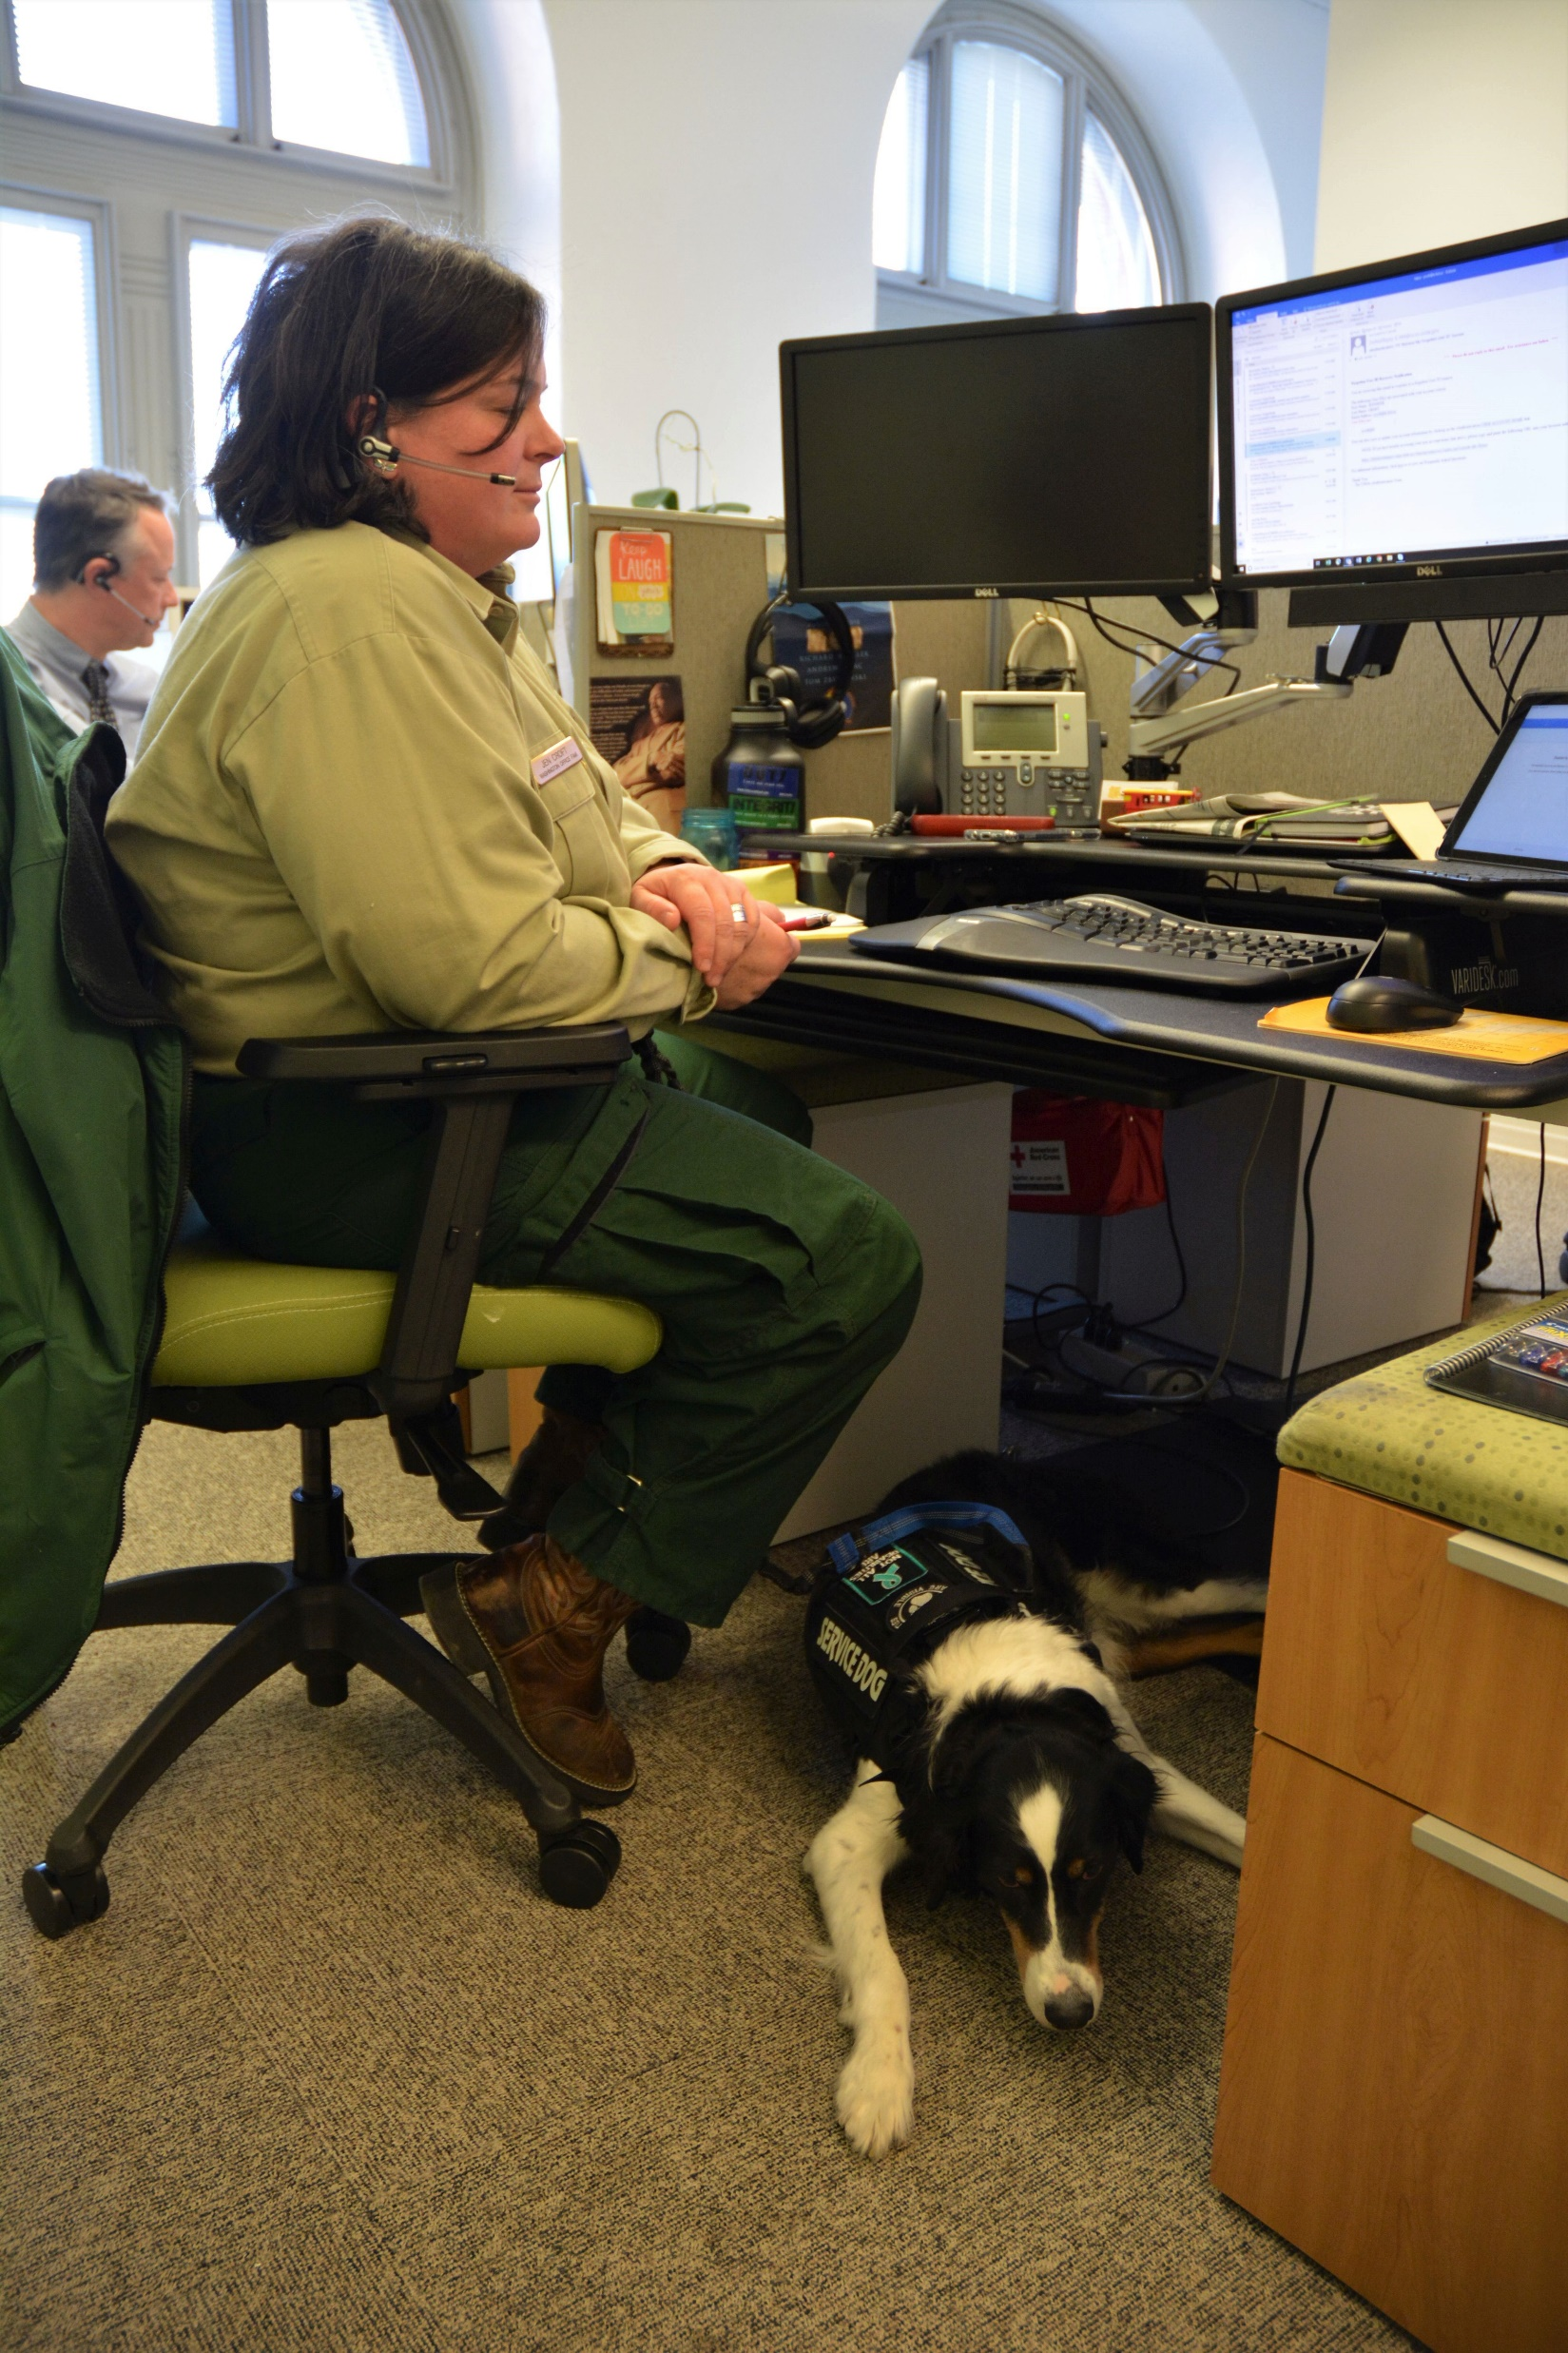

A Day in the Life…
[Another example of what you do in your career]
[Tools you use]
[Props/items to share]
USDA Forest Service photo
by D. Cumberland.
USDA Forest Service photo
by A. McMillan.
Notes:
Design
Add a brief description or example of what you do in your career. Change slide image, if desired. Consider changing the title to fit your presentation.
You could add a short video, which could help to explain your work to the audience and keep them engaged.
Presentation Prompts
Continue to share an example or describe what you do in your career. Consider telling a story - use your five senses, talk about who was there with you, was there a life lesson you learned?
Continue to share some props/items with the audience. Briefly describe the items and pass them around, if possible and appropriate.
You may consider choosing examples that incorporate skills that the students are learning or can understand, such as communication, teamwork, writing, etc.
Placeholder Photo Credits
Jennifer Croft, at her desk in the Forest Service Headquarters. Service Dog at her feet. (Forest Service Photo by D. Cumberland)
RMRS Research Scientist, Katelyn Driscoll, in the RMRS Lab at the Southwestern Regional Office in Albuquerque, NM on 03/27/2019. (Forest Service photo by Andy McMillan, Team Pathways2Solutions)

Slide 9
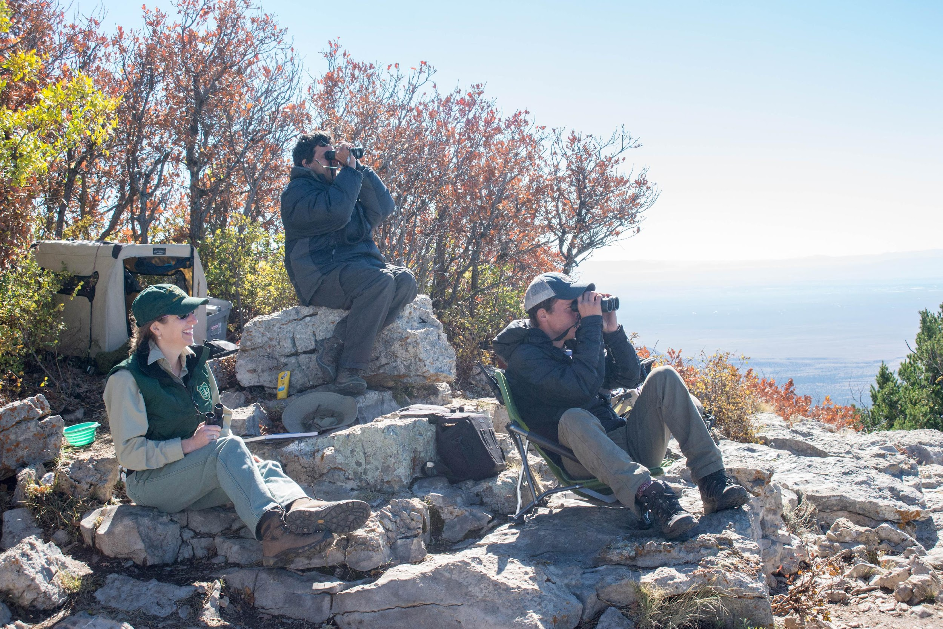
Career Inspiration
[Inspiration(s) for career]
USDA Forest Service photo by G. Hitchcock.
Notes:
Design
Add a brief description of your career inspiration(s). Change slide image, if desired.
Presentation Prompts
What inspired you to pursue this career?
Were there any significant people or an experience that inspired you?
Placeholder Photo Credit
Cibola National Forest, Mountainair, Gavilan Trail, Hawk Watch site. Photo by Gerald Hitchcock.

Slide 10
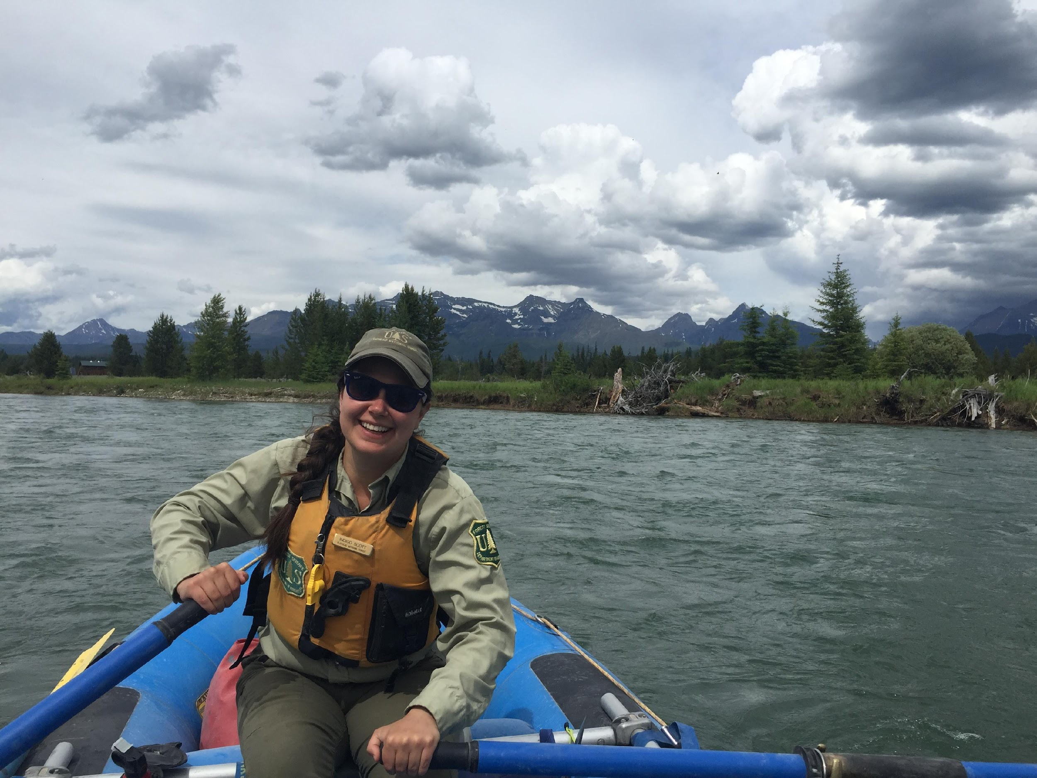
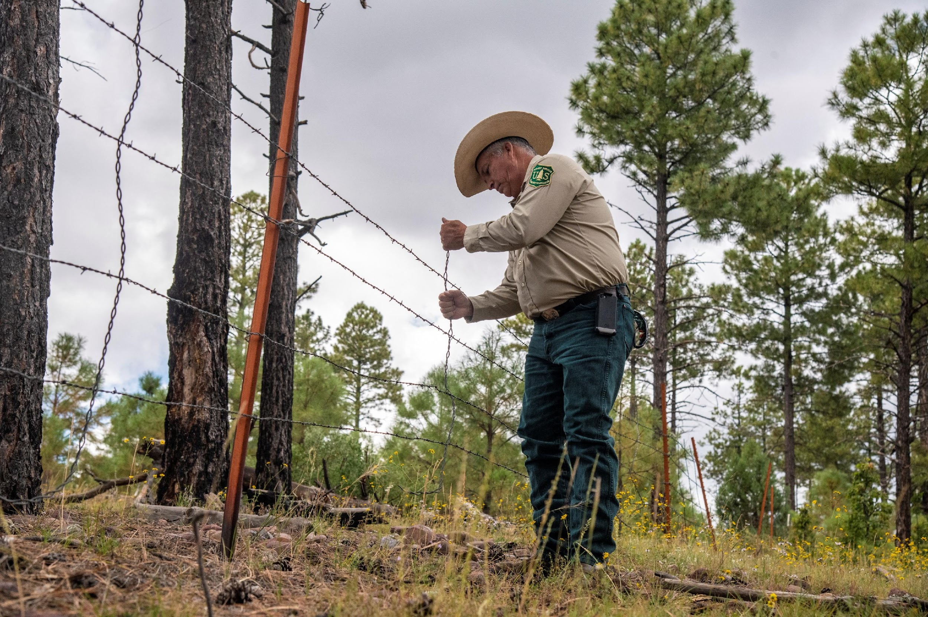
Career Favorites & Challenges
[Favorite part of career]
[Challenges of career]
USDA Forest Service photo
by M. Barnes.
USDA Forest Service photo.
Notes:
Design
Add a brief description of your career favorites and challenges. Change slide images, if desired.
Presentation Prompts
Share your favorites and challenges authentically, keeping in mind appropriate language and stories for a classroom.
What do you like the best about your career?
What is the most challenging thing about your career?
Placeholder Photo Credits
River Ranger on the oars, Upper North Fork Flathead River, Flathead National Forest, Montana. Courtesy photo by Miller Barnes.
Forest Service (FS) Apache-Sitgreaves National Forests, Black Mesa Ranger District Ranger, Richard Madril checks property fence in the Heber Wild Horse Territory, on Sept. 26, 2019.

Slide 11
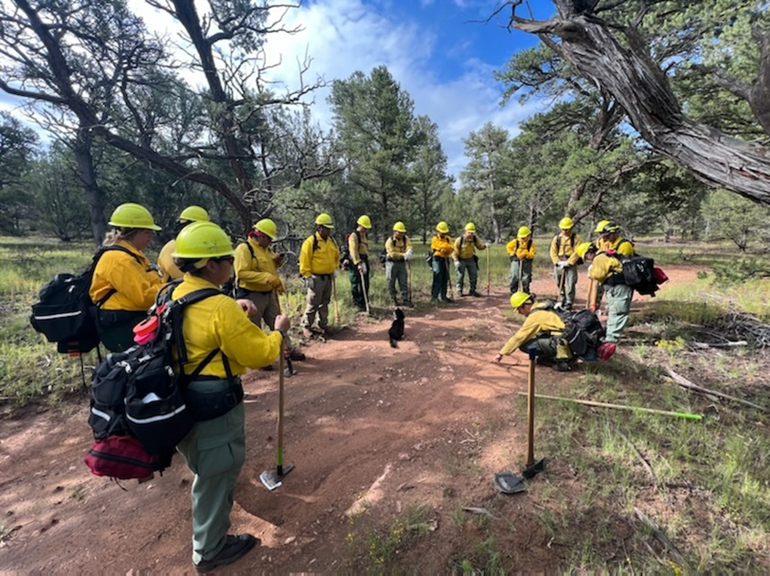
Career Advice
[Advice for this career field]
[Education advice]
[Career preparation advice]
[Future of your career field]
USDA Forest Service photo.
Notes:
Design
Add a brief description of your advice to the students. Change slide image, if desired.
Presentation Prompts
Share any advice you have for students that have interest in your career field.
Keep in mind that from ages 15-18, students can get paid summer jobs on Youth Conservation Corps (YCC) crews - your conversation can inspire them to pursue this work!
What can they do in school to prepare for a career in this field? This can include classes to take, grades, and extracurricular activities.
Consider asking the students what they think they can do to prepare for a career in this field.
Consider emphasizing the importance of education and lifelong learning.
What does the future look like for your career field?
Placeholder Photo Credit
Youth Conservation Corps hosted by partner Wild Arizona. Douglas Ranger District, Coronado National Forest. Photo by USDA Forest Service, Southwestern Region.

Slide 12
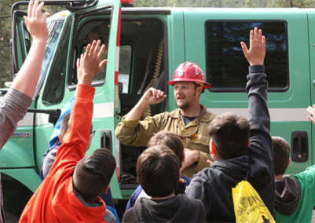
Questions
[Questions]
USDA Forest Service photo by A. Gonzales.
Notes:
Design
Change slide image, if desired.
Presentation Prompts
Allow students time to ask questions.
Share and describe any additional items/props you may have.
Expect to be asked how much you get paid and be prepared to share salary ranges for positions on fire/agency career paths.
Placeholder Photo Credit
Williams Middle School Science Day 2018. Kaibab National Forest. Photo by Art Gonzales.

